Slide 1
Annotating a text to improve understanding

Slide 2
AnNOTATE
“Notate” means “to write.” That is exactly what you will be doing when you annotate a text.
You will be commenting on it and writing notes.
You will be INTERACTING with the text via you’re writing.

Slide 3
Before Reading the Text
Look at the title of the article/story.
What does the title tell you about what you are going to read?
What clues is the author giving you about the subject of the text?

Slide 4
During Reading
While reading, you should…
  Underline main ideas and important information
  Circle words that are unfamiliar to you
  Summarize information as you read
WHY??

Slide 5
During Reading
After reading, you should…
  Clarify meanings and definitions
  Make connections with the text
  Ask Questions

Slide 6
Goal
Find patterns and repetition in order to fully understand the text and determine meaning.
Draw conclusions about author’s purpose, main idea, etc.
If you interact with the text, you will REMEMBER what you read!!!

Slide 7
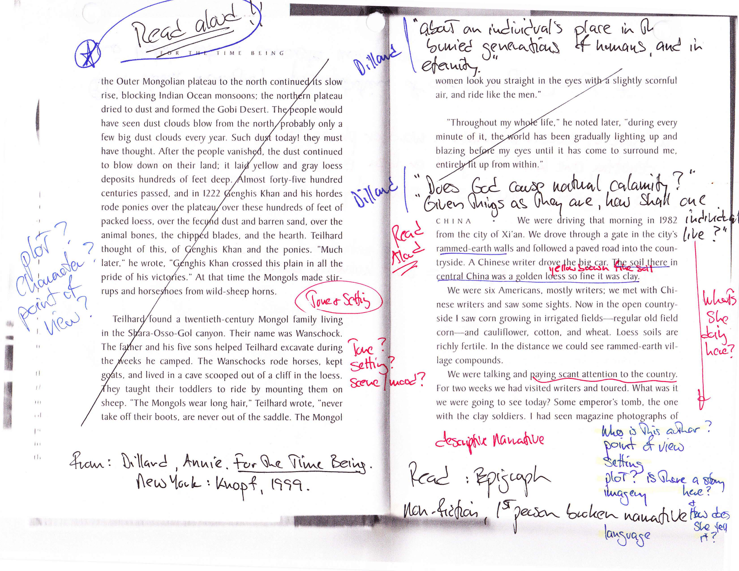

Slide 8
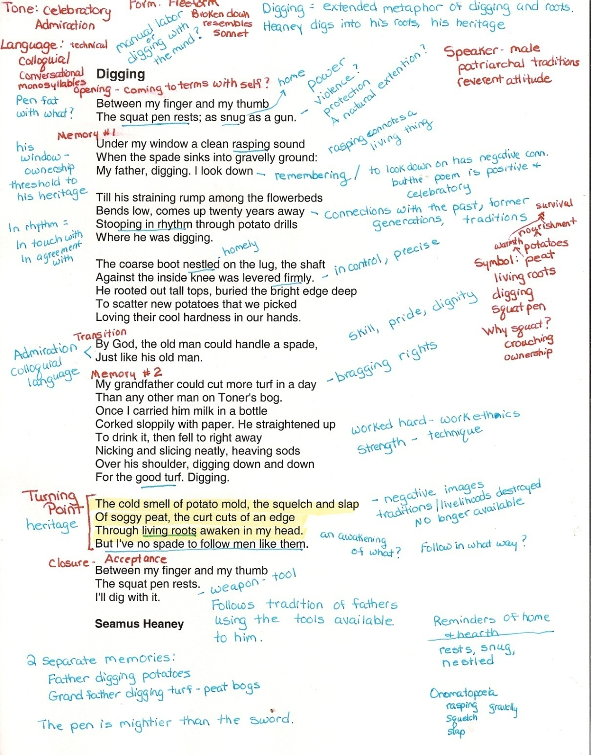

Slide 9


“Introduction to Poetry”
By Billy Collins
I ask them to take a poem
and hold it up to the light
like a color slide
or press an ear against its hive.
I say drop a mouse into a poem
and watch him probe his way out,
or walk inside the poem’s room
and feel the walls for a light switch.
I want them to waterski
across the surface of a poem
waving at the author’s name on the shore.
But all they want to do
is tie the poem to a chair with rope
and torture a confession out of it.
They begin beating it with a hose
to find out what it really means.

Slide 10
After Annotating….
What is it that the author wants a reader to do when they read a poem?
What is it that the author suggests a student wants to do?
What is the difference between these two approaches to understanding a poem?

Slide 11
Question Stems
How does the author achieve….
What is the effect of…
What is the significance of…
How does the speaker/author reveal…
create, develop- mood or tone question
result- figurative language
importance, relevance- word choice, quote, fact, fig. language
illustrate, show- opinion, background, tone

Slide 12
Question Stems
What is the meaning of…
What is the result of…
How does the use of __________enhance…
How does the speaker/author develop…
What can we infer…
How does the author’s use of _________ affect the __________
definition
effect
illustrate, improve, demonstrate
create
determine, guess, conclude
change, modify, improve

